Slide 1
Threaded Extension Section
Hampton and Miriam

Slide 2
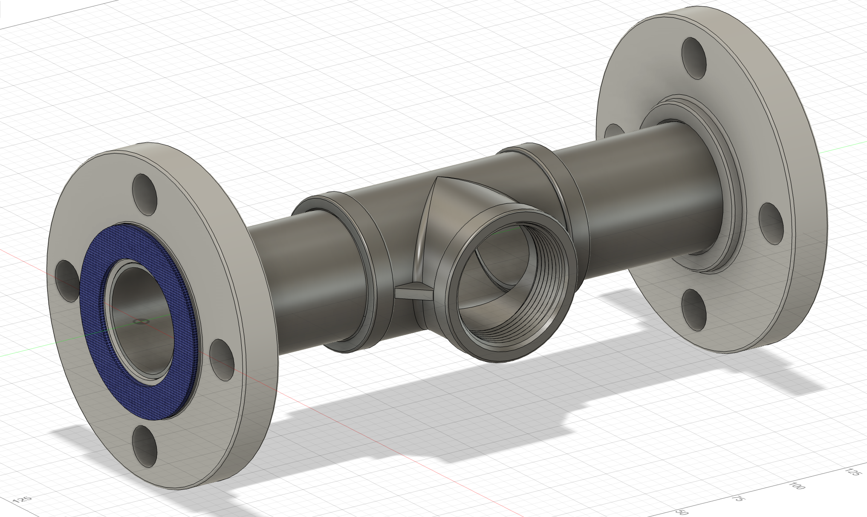
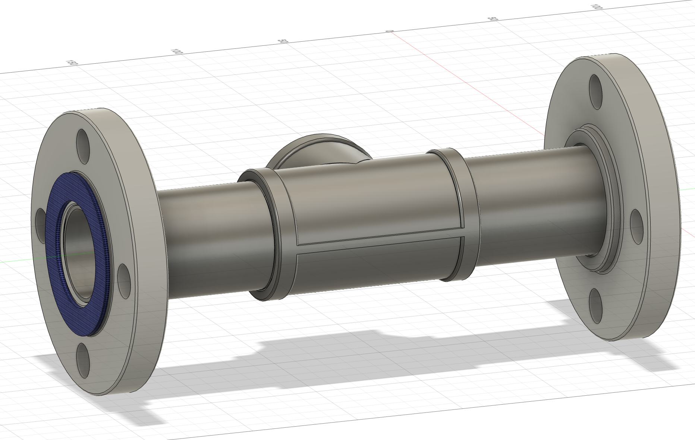
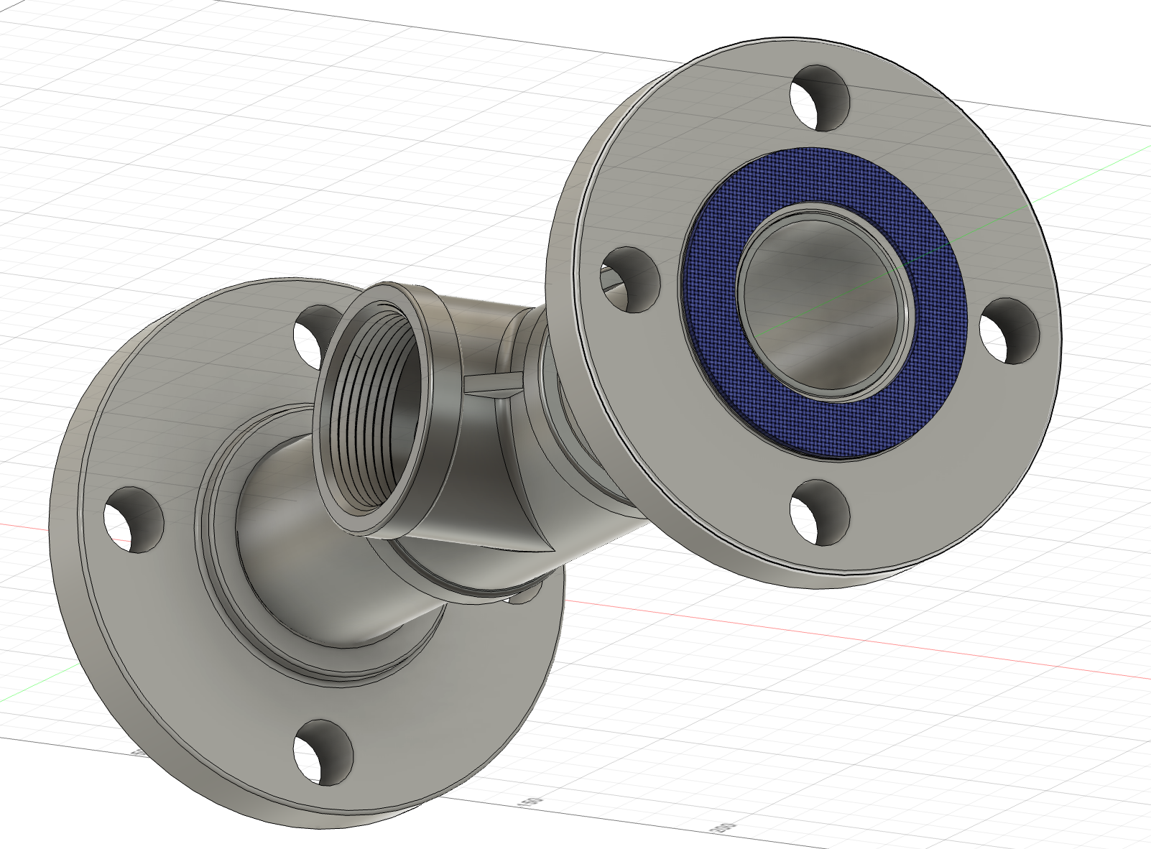
Complete Threaded Extension
Cost
(Flanges) 2 x $91.86 = $183.72
(Pipes) 2 x $15.52 = $31.04 +
(T-Pipe)1 x $47.70 = $47.70
(Seal) 2 x $10.97 = $21.94
--------------------------------------------
Total cost ======= $284.4
Length = 267.4 mm

Slide 6
Components

Slide 7
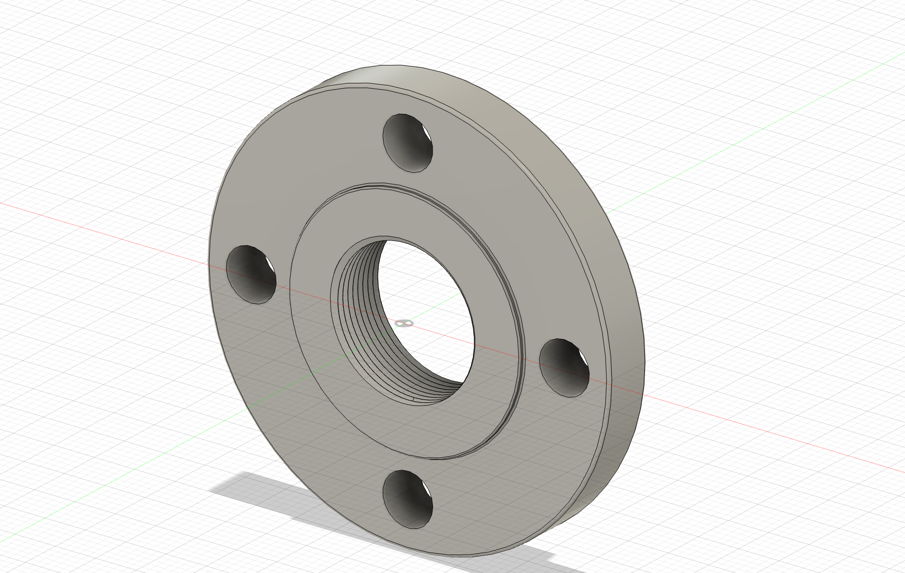
Threaded Flange
Cost
$91.86 each flange
2 flanges used
Total = $183.72
Threaded Flange Grainger Link

Slide 8
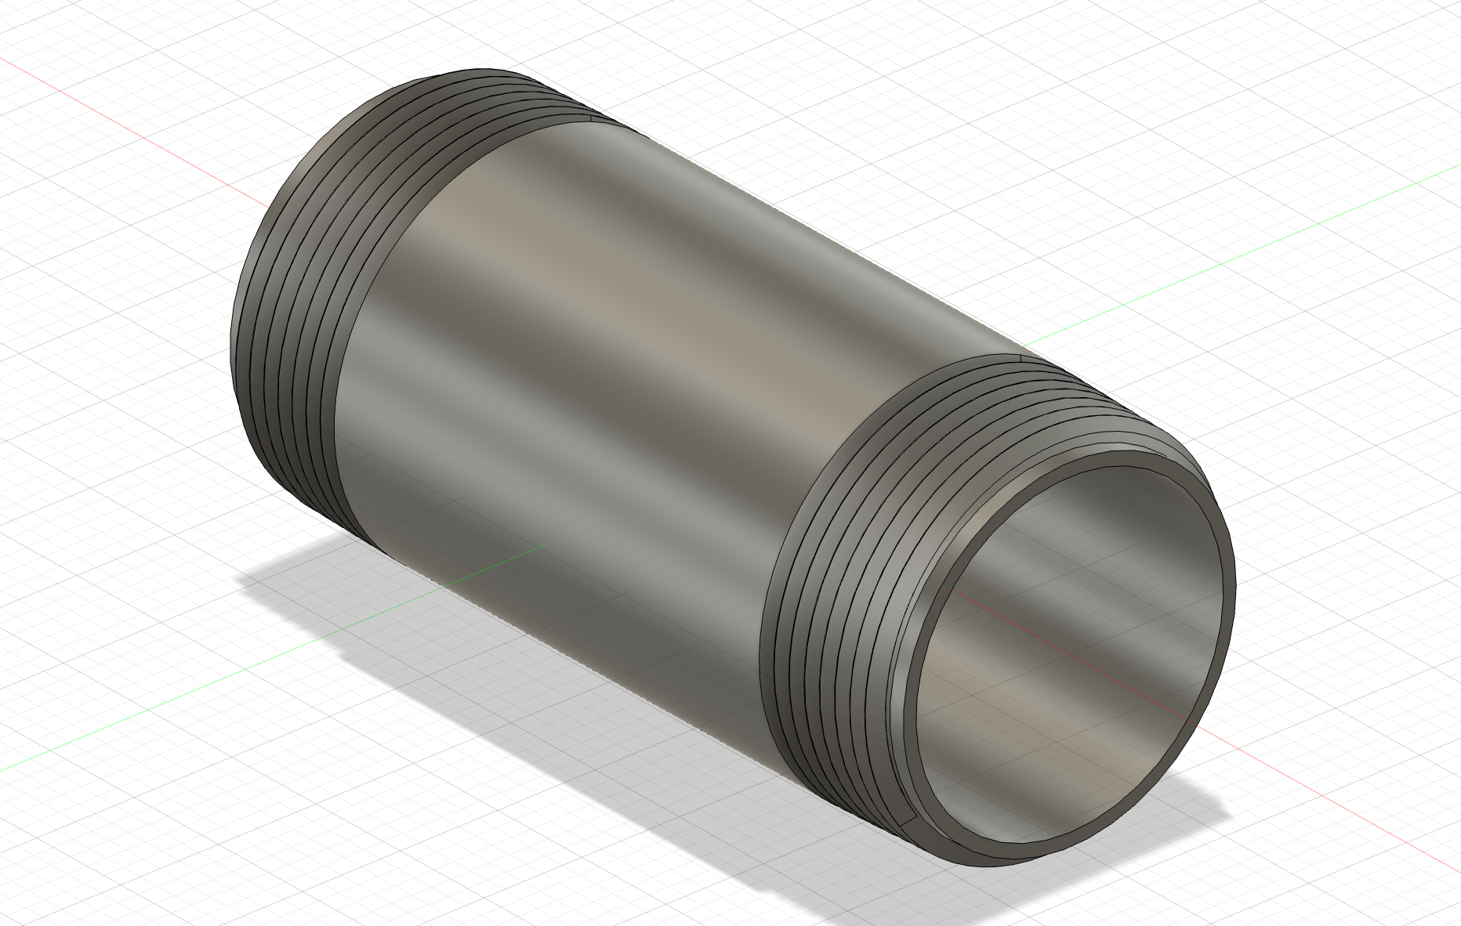
Threaded T-Pipe
Cost
$15.52 each
2 pipes used
Total = $31.04
Threaded Pipe Grainger Link

Slide 9
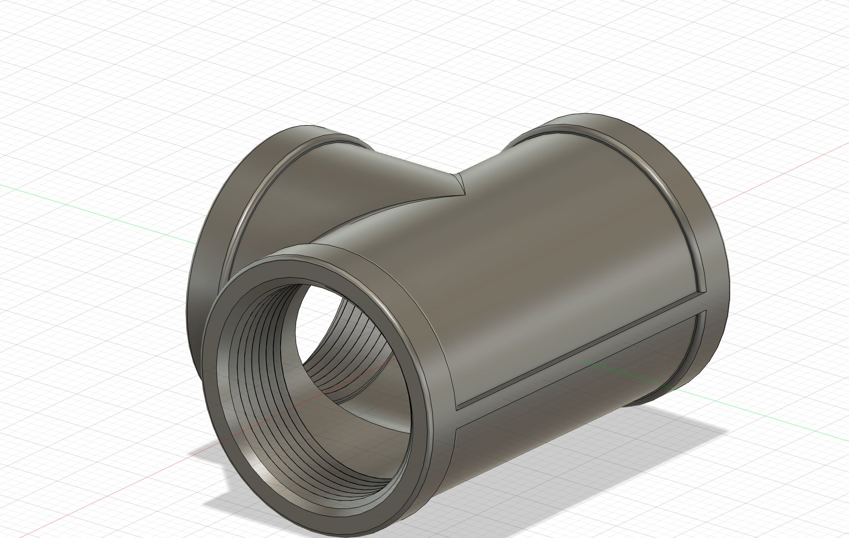
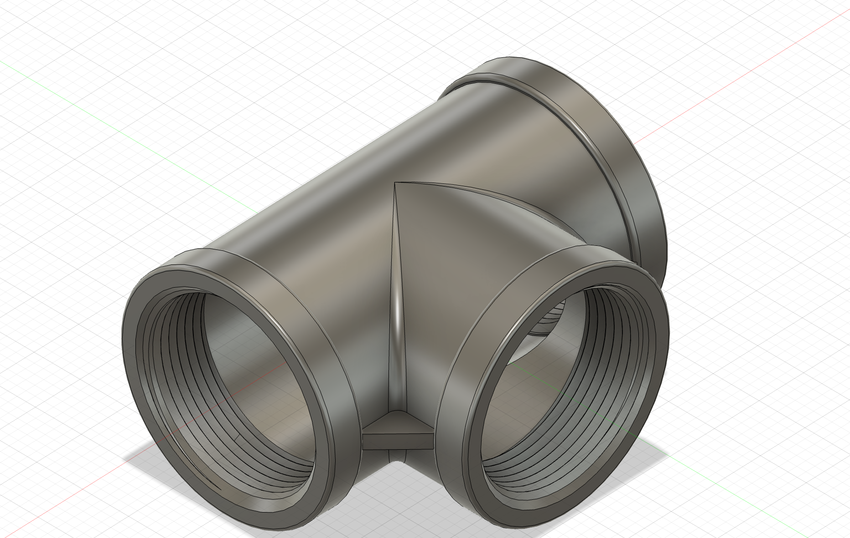
Threaded T-pipe
Cost
$47.70 each
1 T-Pipe used
Total = $47.70
Threaded T-Pipe Grainger Link

Slide 10

Average Flange Blue Seal
Cost
$10.97 each
2 seals used
Total = $21.94
Flange Seal Grainger Link

